Slide 1



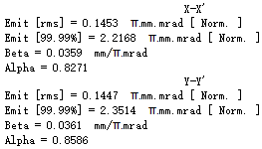
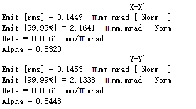
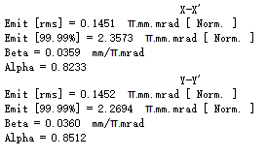
Energy-0.02MeV
Place a drift(1e-005) at the beginning of the lattice file
Place a drift(1e-005) at the end of the lattice file
No drift(1e-005)
Result
Result
Result

Slide 2
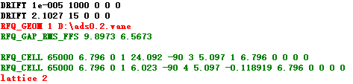
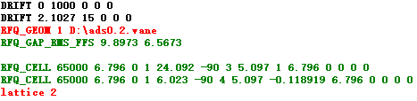

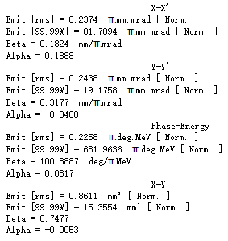
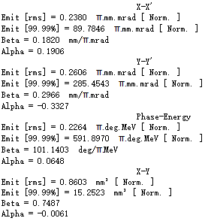
RFQ-energy-0.02MeV
Result
Result

Slide 3
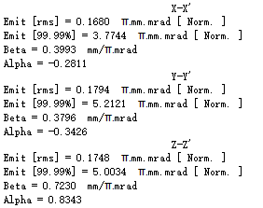
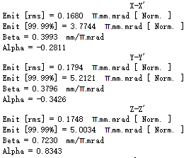
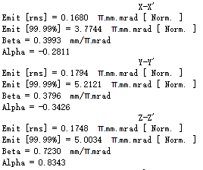
Energy-2.1MeV
Place a drift(1e-005) at the beginning of the lattice file
Place a drift(1e-005) at the end of the lattice file
No drift(1e-005)
Result
Result
Result

Slide 4
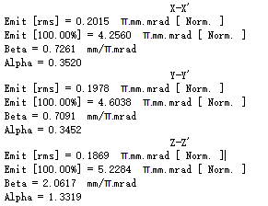
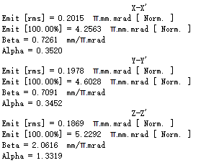
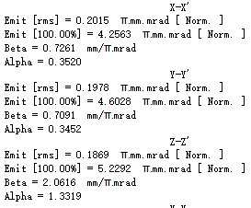
SCEnergy-2.1MeV
Place a drift(1e-005) at the beginning of the lattice file
Place a drift(1e-005) at the end of the lattice file
No drift(1e-005)
Result
Result
Result

Slide 5
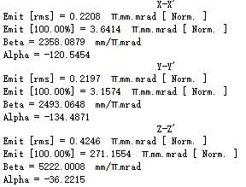
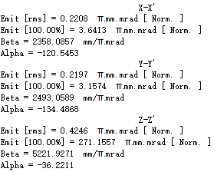
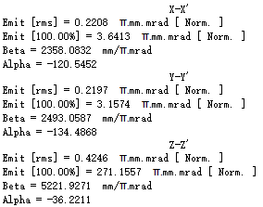
Energy-600MeV
Place a drift(1e-005) at the beginning of the lattice file
Place a drift(1e-005) at the end of the lattice file
No drift(1e-005)
Result
Result
Result

